Slide 1
IR Spectroscopy Part – 2 Analytical chemistry III B.Sc, semester - 5, paper - 6
Vijaya Lakshmi Sada
Guest faculty
P.R. Govt. College (A), kakinada

Slide 2
content
Instrumentation

Slide 3
Instrumentation:
The main parts of an IR spectrometer are:
1. IR radiation source. 2. Monochromators 3. Sample cell and sampling of substance. 4. Detector.

Slide 4
Instrumentation:
1. The IR Radiation Sources:
Infrared instruments need a source of radiant energy which provides a means for isolating narrow frequency band. The radiation source must emit IR radiation which should be:
a. Intense enough for detection b. Steady. c. Extend over the desired wavelengths.
.

Slide 5
Instrumentation:
The various popular source of IR radiation are as follows
a. Incandescent lamp b. Nernest glower c. Globar Source d. Mercury Arc.

Slide 6
Instrumentation:
2. Monochromators
The radiation source emits radiation of various frequency as the sample in IR spectroscopy absorb only at certain frequency, it thus becomes essential to select desired frequencies from the radiation source and reject the radiation of other frequencies. Thus, selection has been achieved by means of Monochromators which are mainly of two types:
a. Prism Monochromators b. Grating Monochromators.

Slide 7
Instrumentation:
3. Sample cells and sampling of substance:
IR spectroscopy has been used for the characterization of solid, liquid or gas samples.
i. Solid – Various techniques are used for preparing solid samples such as pressed pellet technique, solid run in solution, solid films, mull technique etc.

Slide 8
Instrumentation:
ii. Liquid – Samples can be held using a liquid sample cell made of alkali halides. Aqueous solvents cannot be used as they will dissolve alkali halides. Only organic solvents like chloroform can be used.
iii. Gas– Sampling of gas is similar to the sampling of liquids.

Slide 9
Instrumentation:
4. Detector:
The various types of detectors are
a. Bolometers
b. Thermocouples
c. Thermistors
d. Golay cell
e. Photoconductivity cell

Slide 10
Instrumentation:
Single Beam spectrophotometer:
Process
1. In the single – beam system, the radiation is emitted by the source through the sample and then through a fixed prism and rotating Littrow mirror.
2. Both prism and Littrow mirror select the desired wave length and then permit it to pass on to the detector.

Slide 11
Instrumentation:
3. The detector measures the intensity of radiation after passes through the sample.
4. Knowing the original intensity of radiation, one can measure how much radiation has been absorbed.
5. By measuring the degree of absorption at wavelength, the absorption spectrum of the sample can be obtained.

Slide 12
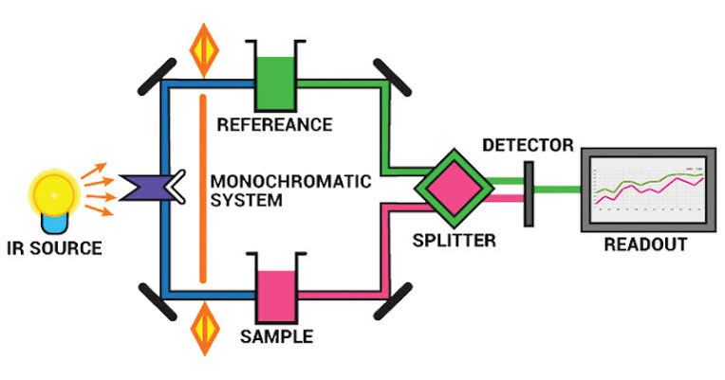

Slide 13
Thank you

